Slide 1

Computer System in Accounting
Ajay Singh

Slide 2



Agenda
Introduction to or meaning of Computer
Elements/Components of Computer
Characteristics/features of Computer
Advantages and Disadvantages
Application areas
Computer System in Accounting
Process of Computing System in Accounting
Importance of Computer System in Accounting
Limitations of Computer System in Accounting
Difference between Manual and Computerized Accounting

Slide 3

Introduction
To Computer

Slide 4
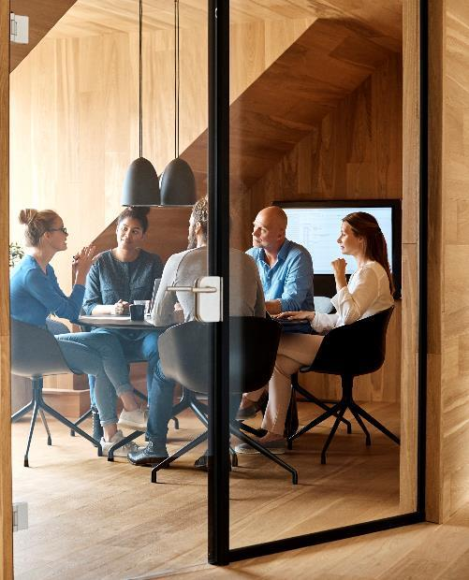



Introduction
A computer is an electronic device that is designed to receive, store, process, and output data. It is a powerful tool that has become an integral part of our daily lives. The computer has evolved over the years from its early beginnings as a simple calculator to a complex machine that can perform millions of calculations per second.

Slide 5
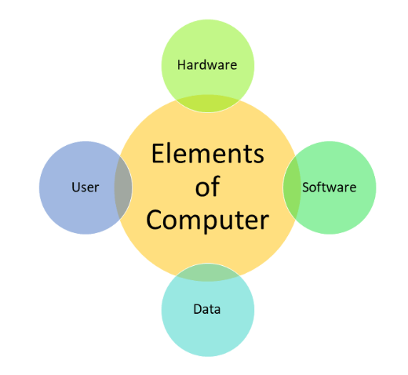
Elements of Computer
Hardware: This refers to the physical components of the computer that you can touch and see.
Software: This refers to the programs and instructions that tell the hardware what to do.
User: Person who operates the computer to accomplish certain task or objective.
Data: Information that is under processing or storage.

Slide 6
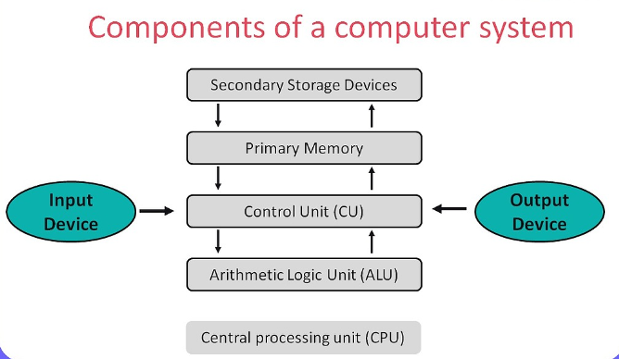
Components of Computer
Hardware
Central Processing Unit (CPU): This is the "brain" of the computer that performs most of the calculations and processes data.
Random Access Memory (RAM): This is the temporary memory that the computer uses to store data while it is working on it.
Hard Disk Drive (HDD) or Solid-State Drive (SSD): These are the primary storage devices that hold all the data and software installed on the computer.
Input devices: These are the devices that allow users to enter data into the computer, such as the keyboard and mouse.
Output devices: These are the devices that display information from the computer, such as the monitor or printer.
Motherboard: This is the main circuit board that connects all the hardware components of the computer.

Slide 7
Characteristics(features) of Computer
S
Speed: Computers can process and execute tasks much faster than humans. They can perform millions of calculations per second, making them ideal for processing large amounts of data quickly.
A
Accuracy: Computers are incredibly accurate and do not make mistakes if they are programmed correctly. They are also able to perform repetitive tasks without getting tired or making errors due to fatigue.
V
Versatility: Computers are incredibly versatile and can be used for a wide range of tasks. They can be used for everything from word processing to gaming to scientific research.
A
R
Reliability: Computers must be reliable and able to perform their intended functions without failure or error. This is especially important for systems that are used for critical tasks such as medical equipment, financial transactions, or air traffic control systems.
Automation: Computers can automate many tasks, making them ideal for tasks that are repetitive or require a high degree of precision.
D
Diligence: Computers must also be diligent, performing tasks with accuracy and attention to detail. A diligent system should be able to perform tasks quickly and efficiently, while also minimizing errors and mistakes. This is important for systems that require a high level of precision, such as scientific simulations or engineering design software.
S
Storage: Computers are able to store vast amounts of data in a very small space. This makes it easy to access and organize information quickly and efficiently.

Slide 8

Advantages of using Computer

Slide 9
Advantages of using Computer
Increased Efficiency: Computers can perform tasks much faster and more accurately than humans, allowing for increased efficiency and productivity. They can also automate repetitive tasks, freeing up time for employees to focus on more complex tasks.
Improved Communication: Computers and the internet have revolutionized communication by allowing people to connect instantly and easily from anywhere in the world. This has made it easier for businesses to communicate with customers and suppliers, and for individuals to stay connected with friends and family.
Access to Information: The internet provides access to a vast amount of information on any topic, making it easier for individuals and businesses to conduct research and make informed decisions.
Cost Savings: Computers can help businesses save money by reducing the need for manual labor, decreasing the amount of paper and other resources used, and reducing the need for office space.
Increased Accuracy: Computers can perform tasks with a high degree of accuracy and consistency, reducing the risk of errors and mistakes.
Better Data Management: Computers make it easy to store, organize, and analyze large amounts of data quickly and efficiently. This can help businesses make more informed decisions and improve their operations.
Enhanced Creativity: Computers provide a platform for creative expression, allowing individuals to create and edit digital media, develop software and apps, and design websites and graphics.

Slide 10
Disadvantages of using Computer

Slide 11
Disadvantages of using Computer
Dependence: Over-reliance on computers can lead to a loss of independence and the ability to think critically and creatively.
Health Risks: Extended use of computers can cause physical health problems such as eye strain, back pain, and repetitive strain injuries (RSIs).
Security Risks: Computers are vulnerable to viruses, malware, and other security threats that can compromise sensitive data and information.
High Cost: Purchasing and maintaining computer hardware and software can be expensive, especially for businesses and organizations.
Technical Issues: Computers can be complex and require technical knowledge to troubleshoot and repair. Technical issues can also cause downtime and disrupt productivity.
Job Loss: Automation and computerization can lead to job loss in certain industries, as machines and software replace human labor.
Social Isolation: Increased use of computers and technology can lead to social isolation and decreased face-to-face communication, which can have negative effects on mental health and well-being.

Slide 12
Application areas of Computers

Slide 13
Application areas of Computers
Business and Finance: Computers are widely used in business and finance for tasks such as accounting, payroll processing, financial analysis, and market research.
Education: Computers are used in education for tasks such as teaching, research, and student administration. They also provide access to online learning resources and educational software.
Healthcare: Computers are used in healthcare for tasks such as electronic medical record-keeping, medical imaging, and patient monitoring.
Entertainment: Computers are used in the entertainment industry for tasks such as video and audio production, animation, and game development.
Science and Engineering: Computers are used in science and engineering for tasks such as data analysis, modeling and simulation, and design and testing.
Communications: Computers are used in communications for tasks such as email, instant messaging, and video conferencing.
Transportation: Computers are used in transportation for tasks such as air traffic control, logistics management, and vehicle control systems.
Government and Public Services: Computers are used in government and public services for tasks such as data management, public safety, and e-government services.

Slide 14
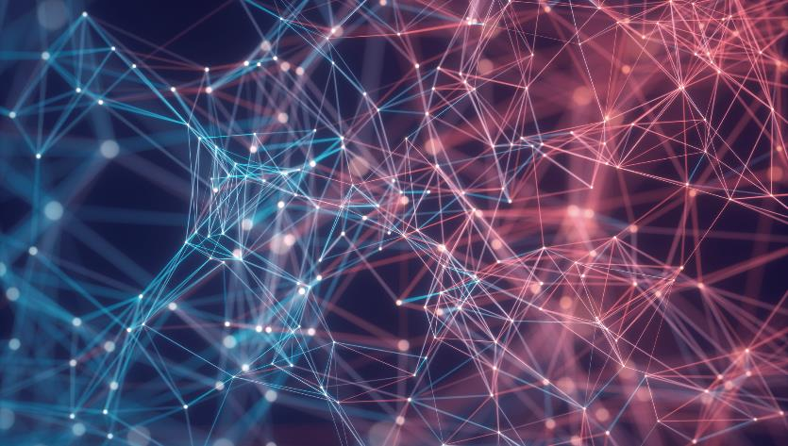

Thank You
Ajay Singh
ajay@mentormaya.com
https://ajaysingh.com.np

